Slide 1
Katzion Dev Task
-by Anushri

Slide 2
Agenda
Requirements
Flow Chart
Solution
Test cases

Slide 3
Requirements
Custom Objects - Transaction, Transaction Items
Make Rest API requests when Transaction Items created
Request #1
Total number of Transaction Items for that Transaction = Transaction count
Send Transaction Items information in JSON format
Request #2
If Request #1 returns Success
Send Transaction information in JSON format

Slide 4
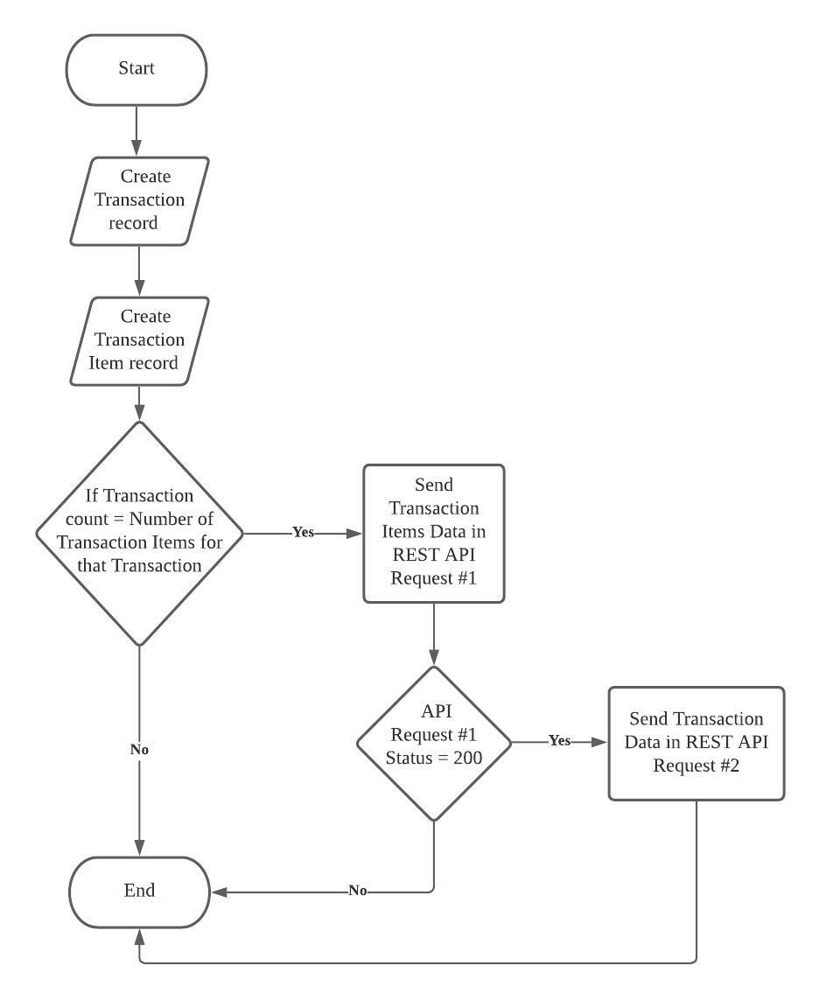
Flow Chart

Slide 5
Solution
Collect all Transaction Ids in a Single Apex Transactions using Apex Triggers
Query DB for Transaction along with Transaction Items in an inner query
Compare Transaction Items related list size with Transaction Record’s field (Transaction_count)
If they are equal then generate both json payloads and go to step 6
Else continue with next transaction
If both payloads are not null make Transaction Item API call and go to step 8
Else continue with next transaction
Check response of Transaction Item API call, if success then call Transaction API call

Slide 6
Test Cases
generateTransactionsData()
Setup method to insert Test data, also to simulate the actual scenario
testJsonPayload()
Unit test for generating Json payload
testDBQueries()
Unit test for getting Transaction records along with Transaction Items records
testRunMethod()
Unit test to process transactions

